Slide 1
LESSON 3
VARIANCE OF A SAMPLING DISTRIBUTION

Slide 2
At the end of this lesson, the learner should be able to
accurately compute the variance of a population and a sampling distribution; and
correctly solve problems involving variance of a sample distribution.

Slide 3
What is the difference between the variance of a population and a sample distribution?
How do we compute for the variance of a sampling distribution?

Slide 4
How was variance derived, and how is it related to the mean?
How important is it to know a data’s variance and standard deviation?
If the variance and the standard deviation are important to a population, do you think it is also important to a sampling distribution?

Slide 5

1
Variance of a Population
describes the dispersion or the variability of the population
It can be computed using the formula
$$σ^{2}=\frac{\sum{X^{2}−\frac{{\left(\sum{X}\right)}^{2}}{N}}}{N}.$$

Slide 6
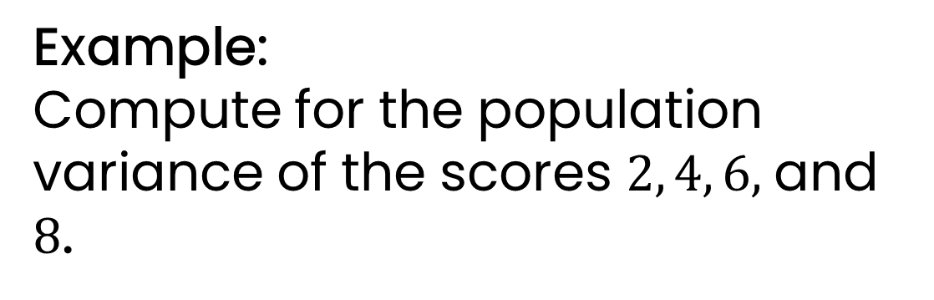

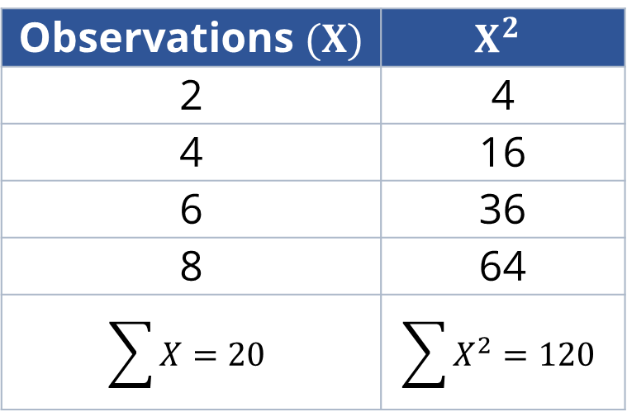
Example:
Compute for the population variance of the scores $2, 4, 6,$and $8$.
Observations $(X)$ | $$X^{2}$$
2 | 4
4 | 16
6 | 36
8 | 64
$$\sum{X=20}$$ | $$\sum{X^{2}=120}$$
$$σ^{2}=\frac{\sum{X^{2}−\frac{{\left(\sum{X}\right)}^{2}}{N}}}{N} \\ σ^{2}=\frac{120−\frac{{\left(20\right)}^{2}}{4}}{4} \\ σ^{2}=5$$

Slide 7
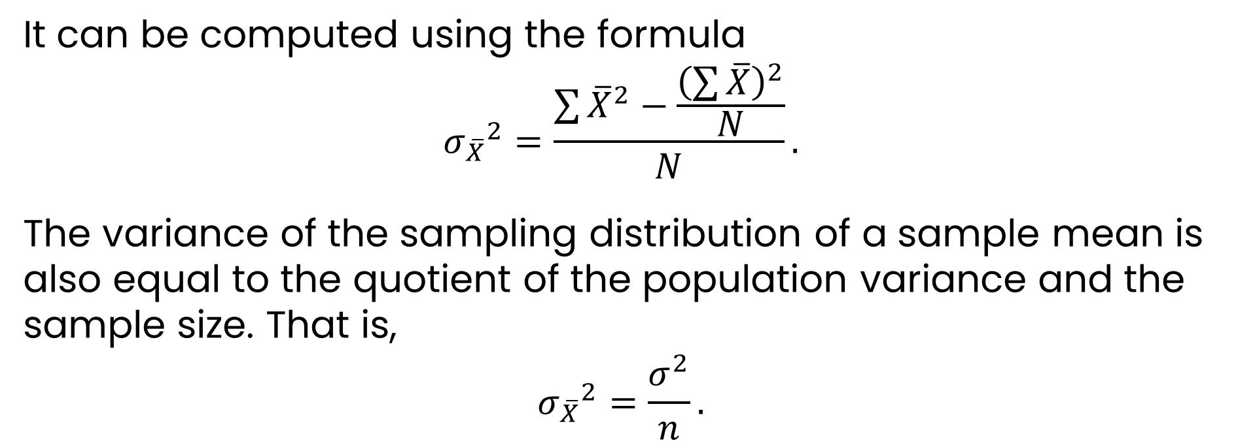
2
Variance of the Sampling Distribution
the variability of the sample means
It can be computed using the formula
$${σ_{\overline{X}}}^{2}=\frac{\sum{{\overline{X}}^{2}−\frac{{\left(\sum{\overline{X}}\right)}^{2}}{N}}}{N}.$$
The variance of the sampling distribution of a sample mean is also equal to the quotient of the population variance and the sample size. That is,
$${σ_{\overline{X}}}^{2}=\frac{σ^{2}}{n}.$$

Slide 8
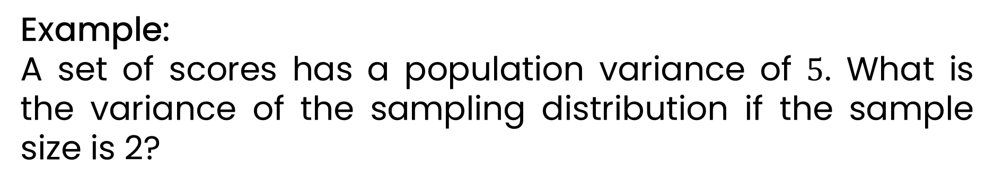

2
Variance of the Sampling Distribution
the variability of the sample means
Example:
A set of scores has a population variance of $5$. What is the variance of the sampling distribution if the sample size is 2?
${σ_{\overline{X}}}^{2}=\frac{σ^{2}}{n}=\frac{5}{2}=2.5$

Slide 9
Example 1: A population consists of five values: 2, 3, 4, 5, and 6. Compute for the variance of the sampling distribution of the sample mean if the sample of size 2 is to be taken from the population.

Slide 10
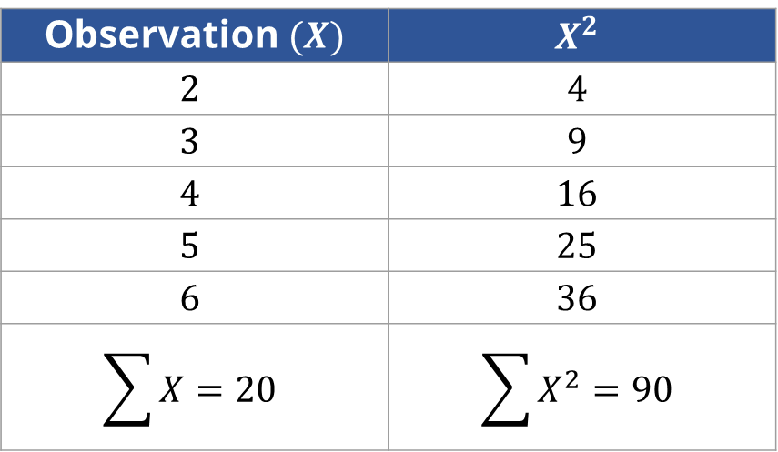
Solution:
1. Compute for the variance of the population.
Observation $(X)$ | $$X^{2}$$
$$2$$ | $$4$$
$$3$$ | $$9$$
$$4$$ | $$16$$
$$5$$ | $$25$$
$$6$$ | $$36$$
$$\sum{X}=20$$ | $$\sum{X^{2}=90}$$

Slide 11
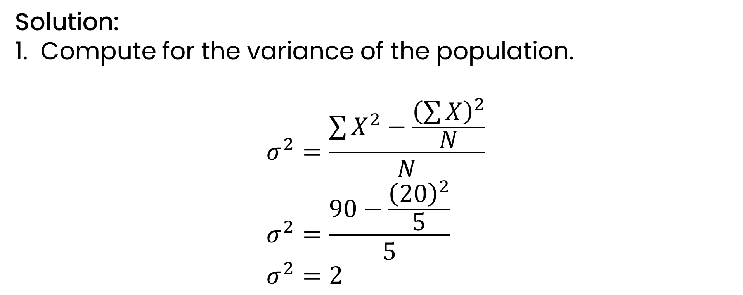
Solution:
1. Compute for the variance of the population.
$$σ^{2}=\frac{\sum{X^{2}−\frac{{\left(\sum{X}\right)}^{2}}{N}}}{N} \\ σ^{2}=\frac{90−\frac{{\left(20\right)}^{2}}{5}}{5} \\ σ^{2}=2$$

Slide 12
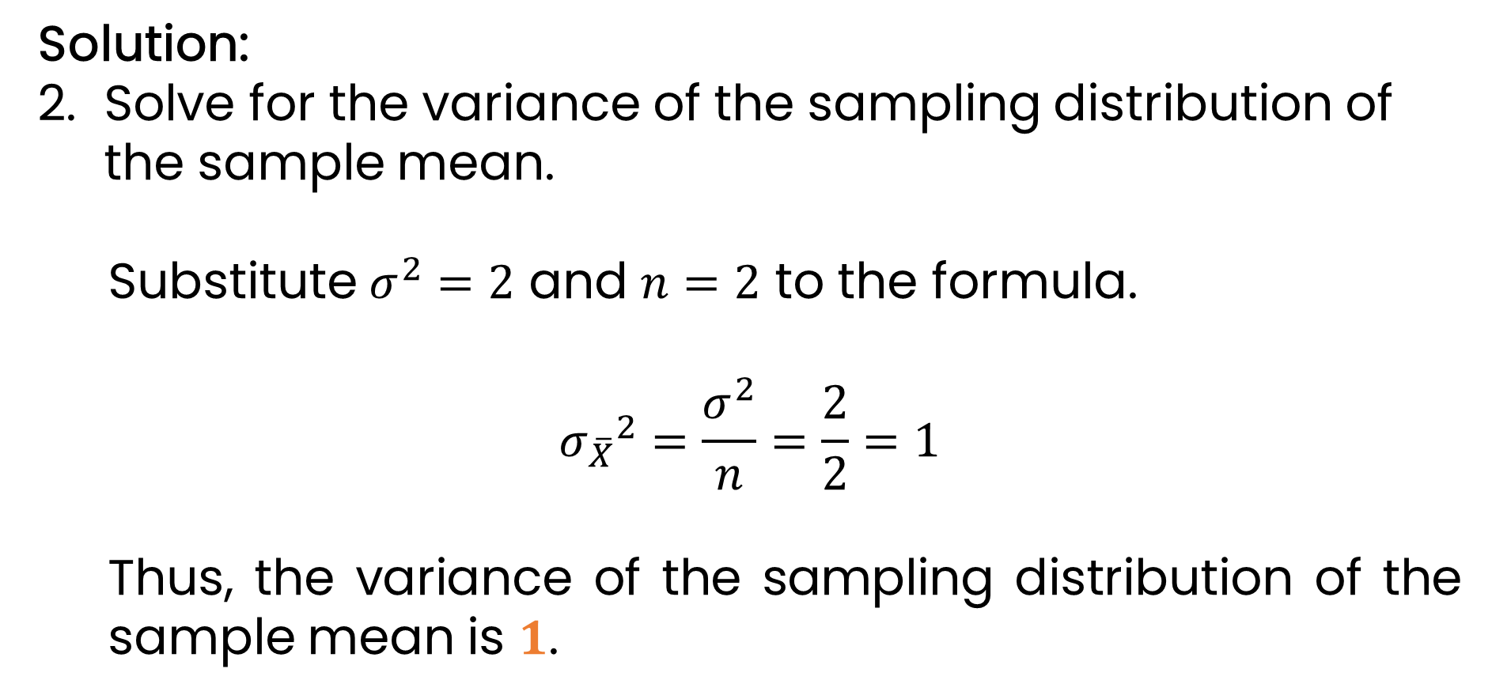
Solution:
Solve for the variance of the sampling distribution of the sample mean.
Substitute $σ^{2}=2$ and $n=2$ to the formula.
$${σ_{\overline{X}}}^{2}=\frac{σ^{2}}{n}=\frac{2}{2}=1$$
Thus, the variance of the sampling distribution of the sample mean is $1$.

Slide 13
Example 2: From the given in Example 1, construct the sampling distribution of the samples of size 2 and compute for the variance of the sampling distribution.

Slide 14
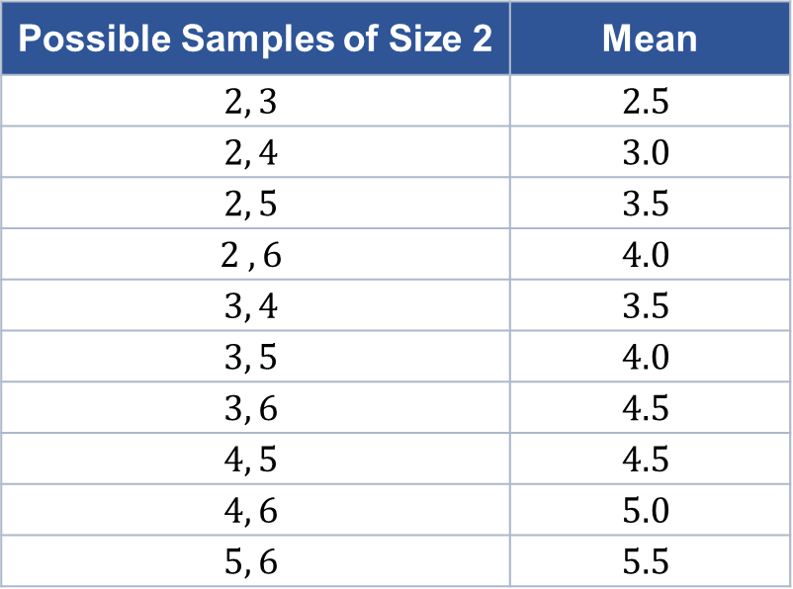
Solution:
List all the possible samples of size 2 and their corresponding mean.
Possible Samples of Size 2 | Mean
$$2, 3$$ | $$2.5$$
$$2, 4$$ | $$3.0$$
$$2, 5$$ | $$3.5$$
$$2 ,6$$ | $$4.0$$
$$3, 4$$ | $$3.5$$
$$3, 5$$ | $$4.0$$
$$3, 6$$ | $$4.5$$
$$4, 5$$ | $$4.5$$
$$4, 6$$ | $$5.0$$
$$5, 6$$ | $$5.5$$

Slide 15
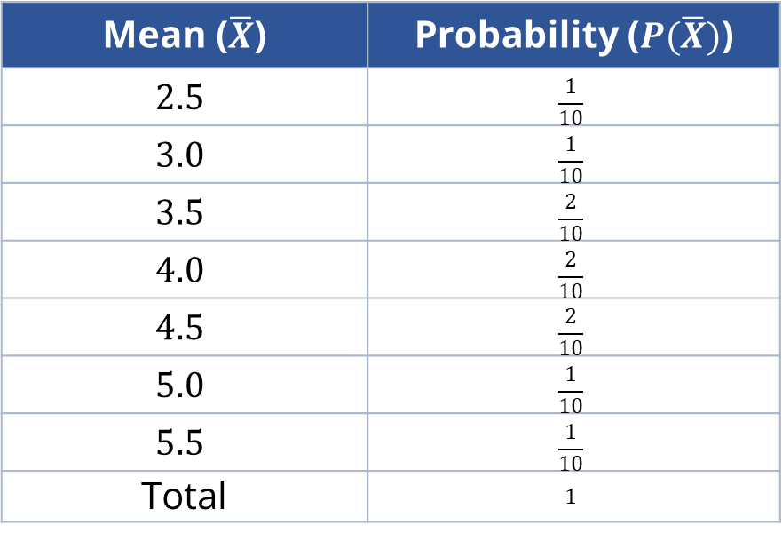
Solution:
Construct the sampling distribution of the sample mean.
Mean ($\overline{X}$) | Probability ($P(\overline{X})$)
$$2.5$$ | $$\frac{1}{10}$$
$$3.0$$ | $$\frac{1}{10}$$
$$3.5$$ | $$\frac{2}{10}$$
$$4.0$$ | $$\frac{2}{10}$$
$$4.5$$ | $$\frac{2}{10}$$
$$5.0$$ | $$\frac{1}{10}$$
$$5.5$$ | $$\frac{1}{10}$$
Total | $$1$$

Slide 16
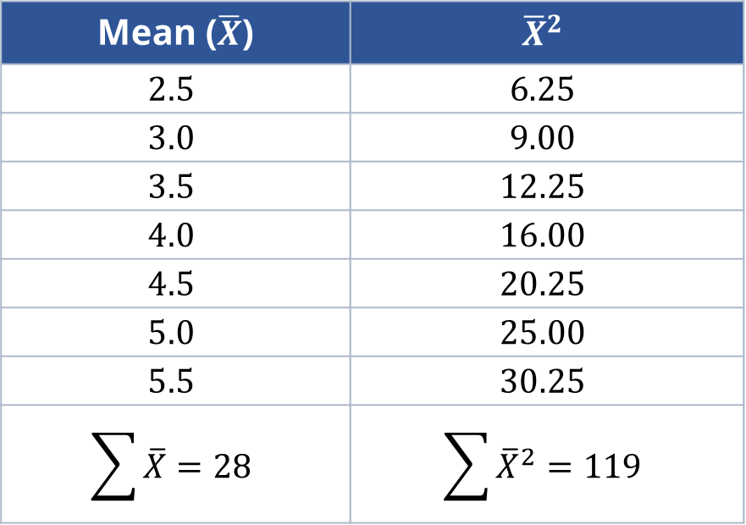
Solution:
Solve for the variance of the sampling distribution of the sample mean.
Mean ($\overline{X}$) | $${\overline{X}}^{2}$$
$$2.5$$ | $$6.25$$
$$3.0$$ | $$9.00$$
$$3.5$$ | $$12.25$$
$$4.0$$ | $$16.00$$
$$4.5$$ | $$20.25$$
$$5.0$$ | $$25.00$$
$$5.5$$ | $$30.25$$
$$\sum{\overline{X}=28}$$ | $$\sum{{\overline{X}}^{2}=119}$$

Slide 17
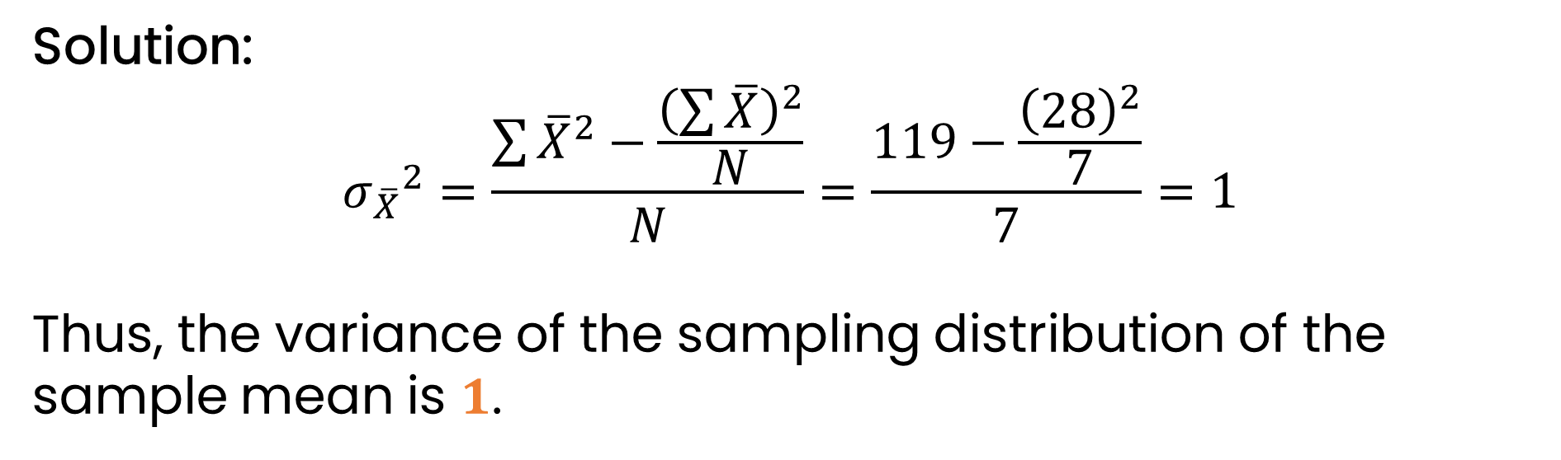
Solution:
$${σ_{\overline{X}}}^{2}=\frac{\sum{{\overline{X}}^{2}−\frac{{\left(\sum{\overline{X}}\right)}^{2}}{N}}}{N}=\frac{119−\frac{{\left(28\right)}^{2}}{7}}{7}=1$$
Thus, the variance of the sampling distribution of the sample mean is $1$.

Slide 18
Individual Practice:
The following table gives the monthly sales (in millions) of big franchising companies. Suppose that random samples of size 4 are taken from this population of six franchising companies. Compute for the population variance.
Company | Sales (in Millions)
X | 8
Y | 12
Z | 16
S | 20
T | 24
U | 28

Slide 19
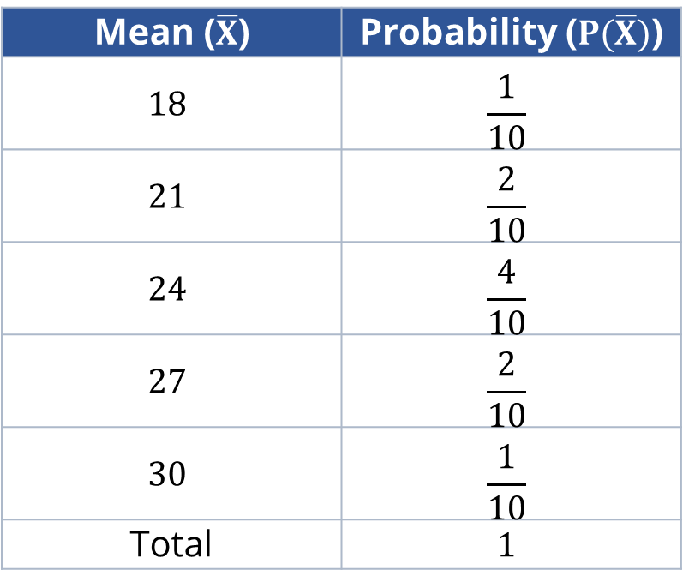
Individual Practice:
Compute for the variance of the sampling distribution of the sample mean of size 4 from the given data at the right.
Mean ($\overline{X}$) | Probability ($P(\overline{X})$)
$$18$$ | $$\frac{1}{10}$$
$$21$$ | $$\frac{2}{10}$$
$$24$$ | $$\frac{4}{10}$$
$$27$$ | $$\frac{2}{10}$$
$$30$$ | $$\frac{1}{10}$$
Total | $$1$$

Slide 20
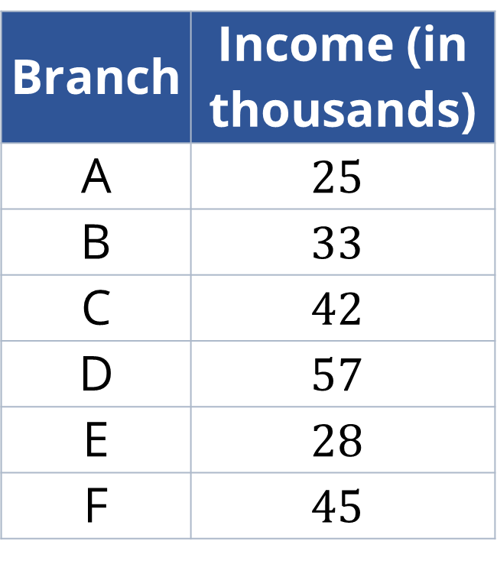
Group Practice: To be done in 5 groups.
Six of the branches of a fast-food chain reported their income (in thousands) in a day. If three branches are selected at random, compute the variance of the sampling distribution for the sample mean.
Branch | Income (in thousands)
A | $$25$$
B | $$33$$
C | $$42$$
D | $$57$$
E | $$28$$
F | $$45$$

Slide 21
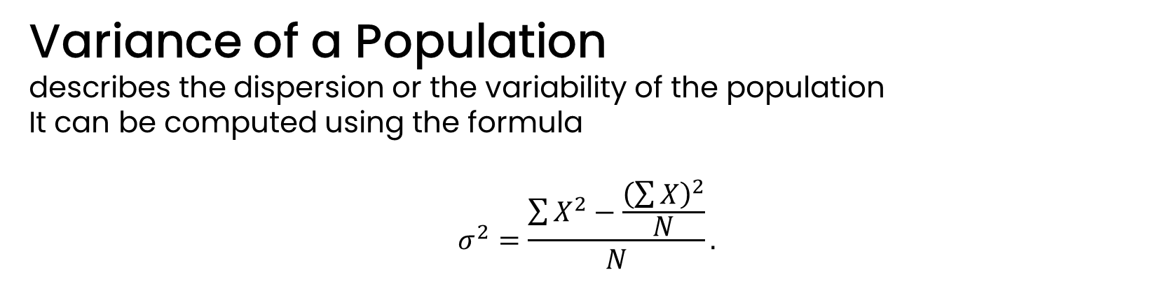
1
Variance of a Population
describes the dispersion or the variability of the population
It can be computed using the formula
$$σ^{2}=\frac{\sum{X^{2}−\frac{{\left(\sum{X}\right)}^{2}}{N}}}{N}.$$

Slide 22
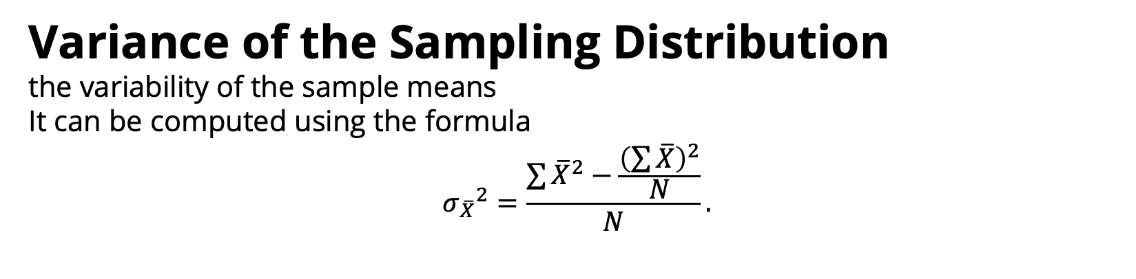
2
Variance of the Sampling Distribution
the variability of the sample means
It can be computed using the formula
$${σ_{\overline{X}}}^{2}=\frac{\sum{{\overline{X}}^{2}−\frac{{\left(\sum{\overline{X}}\right)}^{2}}{N}}}{N}.$$

Slide 23
How do we compute for the variance of the population and the sampling distribution?
Did you encounter problems in solving for the variance? Did you stop and leave the problem, or did you get up and try again?
What is the standard error of the mean?

